Slide 1
SATS Stress Workshop
The Healthy Minds Team – NHS
Lucy Tarn- Education Mental Health Practitioner
Notes:
Briefly introduce myself and HMT
Appreciate may be mixed emotions at present – excitement, fear, worry. Feeling pressured. Some take this easier than others.
Nothing Im going to say is revolutionary, but can still be helpful reminder of things we can do to help ourselves when stressed and under pressure.

Slide 2
Aims For Today
What is stress?
The stress cycle
Managing stress
The stress bucket
Unhelpful thinking
To discuss ways to feel less stressed during exam periods

Slide 3
How are you feeling about your upcoming exams?

Slide 4
What is Stress?
Stress is a NORMAL emotion that can be useful and help you improve.
It can become a problem when it starts to impact your everyday life.
Stress can negatively impact on your mood, social life and academic performance.
Notes:
“Stress is a normal emotion that everyone will feel at some point in their lives. It can sometimes be helpful to enhance our performance, however it can become a problem when it starts to interfere with our everyday life. For example: It might start to impact our social life, academic performance and mood. This is when we might need some extra help.” “Too much stress can affect our mood, body and our relationships with others- especially when its out of control. It can make us feel anxious and irritable and even affect our self-esteem. Experiencing a lot of stress over a long period of time can also lead to a feeling of physical, mental and emotional exhaustion, this is often called burnout. (Resource reference I heart CBT and NHS England, 2021)

Slide 5
What is Stress?
Difficulty concentrating
Finding it difficult to meet deadlines
Racing thoughts/overthinking
Sleeping badly
Signs of Stress
Feeling overwhelmed
Avoiding people and things
Feeling nervous, worried or scared
Eating poorly
Taking on too much

Slide 6
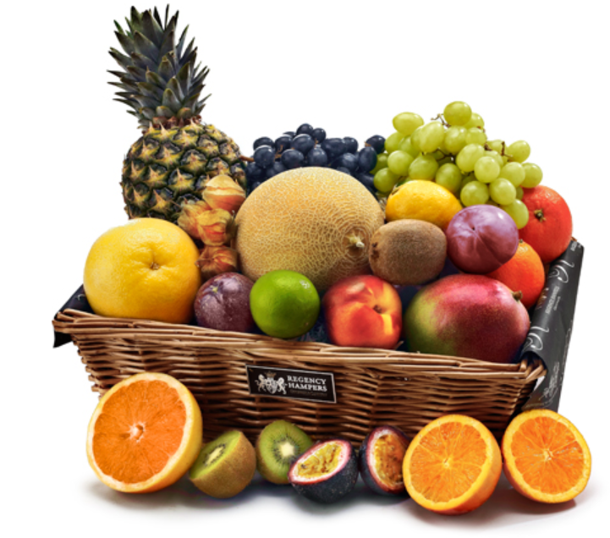
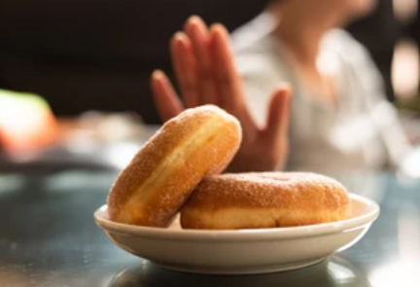
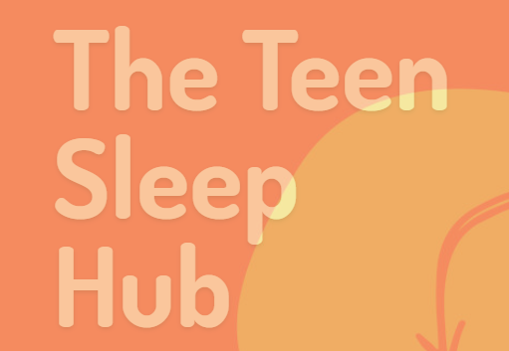
Managing Stress
Drinks
To maximise your focus when revising it is important to stay hydrated. Even slight dehydration can lead to headaches, reduced concentration and being less alert!
Drink water – if not drink milk or small amounts of fruit juice. Tea and coffee count but are high in caffeine. It’s best to avoid sweet fizzy and energy drinks as they are high in sugar and can lead to energy peaks but also energy slumps
Foods
Eating a balanced diet can help focus and avoid illness. Eating fruit and vegetables are good as energy is released slowly, therefore, preventing energy slumps and peaks. Foods high in sugar such as cakes and sweets will cause energy peaks and then slumps!
Food and Sleep
We all know if we sleep better we can concentrate better. Some tips about food and sleep
Don’t eat a massive meal just before going to bed as it can interfere with your sleep.
If you need a snack before bed have dried fruit rather than sugar
Avoid caffeine – tea, coffee, cola, energy drinks and chocolate
A warm glass of milk before bedtime can help you sleep better
Lot’s of advice on how to sleep better

Slide 7
Thoughts: I can’t do this! I am going to fail!
Behaviour: revise more and more, do not see friends, stay in room, stay up late
Feeling: Stressed, worried, frustrated
Body: feel sick, shaking heart beating fast
The Vicious Cycle

Slide 8
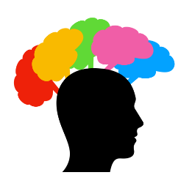
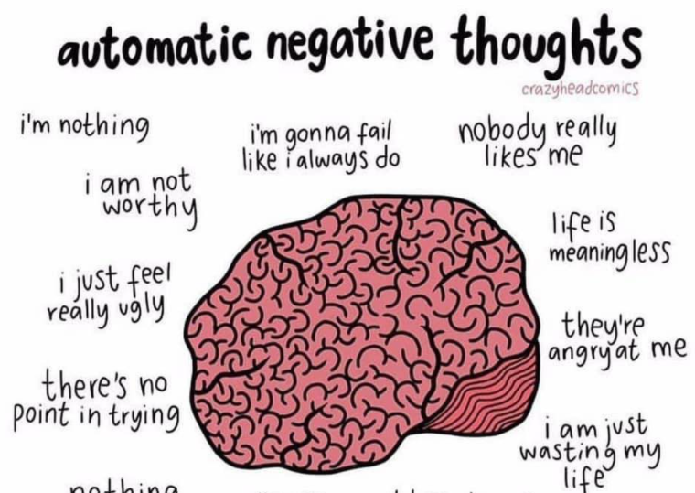
Unhelpful Thinking
Red/ Green Thoughts
Thinking is AUTOMATIC, however when you are stressed, you might notice that your thoughts can be negative, for example:
I think things will go wrong
I will fail
I can’t do this
What if something bad happens

Slide 9
Negative Automatic Thoughts (NATS)
Why do we need to know about them?
If we know about them then we can start to notice them when they arrive and we can change them and swap it for a positive and helpful thought.
I have only done 2 hours of study becomes I have studied hard for 2 hours today and I am pleased I looked at …
I am going to fail becomes I am going to try my best and see what happens

Slide 10
Thoughts: I am trying my best and I am continuing to learn all the time
Behaviour: doing the things we enjoy, seeing friends, focused revision time
Feeling: Confident, calm
Body: Muscles less tense, more focused, relaxed

Slide 11
I am trying my best!
I am studying and I am learning all of the time
Positive Affirmations
I love being challenged by interesting subjects
In a couple of months/weeks/days this will all be over
I am working hard!
I can only do what I can do
I can’t wait to show of what I have learned in lessons
I can do this!
If you notice any NATS, try practicing positive affirmations! It can help to write them down and repeat them whenever you need to.

Slide 12
The circle of control
Things I can control
Things I can’t control
https://youtu.be/7YIK0I5coOA
Notes:
Picture a circle, imagine writing down all of your worries. Everything that we can control goes inside of the circle, and everything we can’t control goes outside of the circle. There are many things in our life where we might not have control over what happens. The best way of handling this is accepting that this is okay, and to focus on the things that we can control, so that we feel more calm and prepared to face the things that we can’t control. How to manage your worries | Circles of Control | British Red Cross - YouTube

Slide 13
The circle of control
Things I can control
Trying my best
Learning from my mistakes
Trying new strategies
Having regular breaks
Asking for help
Eating healthy and exercising
Being poorly
What questions come up on the exam on the day
What other people say, do or think
Things I can’t control
Notes:
Picture a circle, imagine writing down all of your worries. Everything that we can control goes inside of the circle, and everything we can’t control goes outside of the circle. There are many things in our life where we might not have control over what happens. The best way of handling this is accepting that this is okay, and to focus on the things that we can control, so that we feel more calm and prepared to face the things that we can’t control. How to manage your worries | Circles of Control | British Red Cross - YouTube

Slide 14
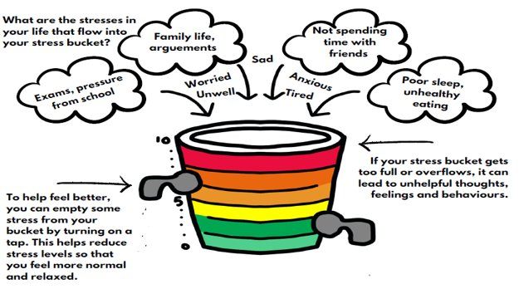
The Stress Bucket
Notes:
Ask for ideas from audience. Link for stress bucket worksheet: https://mentallywellschools.co.uk/wp-content/uploads/2021/05/My-Stress-Bucket-sheet.pdf

Slide 15
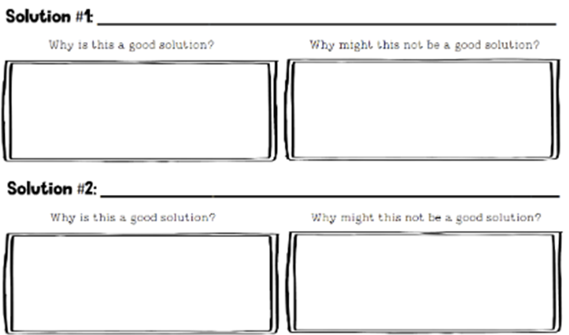
Problem Solving
Step 1
What is the problem?
Step 2
Let’s think of some ideas to solve this problem.
Step 3
Let’s choose two of your best ideas and think what is good and
not so good about those ideas.
Step 4
Which one is more likely to work? Let’s choose the best idea!
Step 5
Plan out step by step what you need to do to solve the problem.
What?
When?
How?
With who?
Are there any problems? How can you overcome them?

Slide 16
Top Tips for making sure your stress bucket does not overflow
Talk to a trusted adult, ask a friend for advice or seek support from other sources such as Kooth, Childline or YoungMinds.
Find ways to relax and take regular breaks throughout revision. Set a timer so you don’t forget!
Stay healthy! Ensure you eat 3 healthy meals a day and stay hydrated.
Exercise- staying active can clear your mind and give you more energy.
Self care- do things that make you feel calm and relaxed.
Get enough sleep- avoid staying up late revising. Avoid caffeine and avoid devices when preparing to sleep. For advice around sleeping, go to the Teen Sleep Hub.

Slide 17
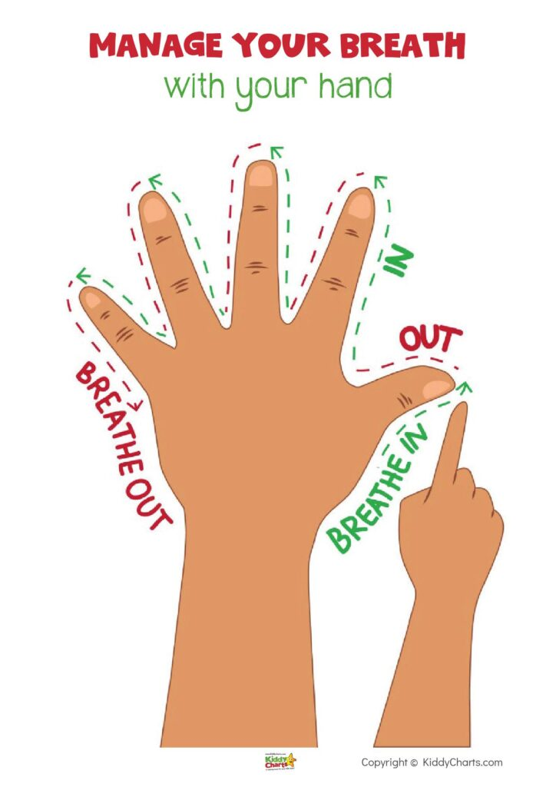
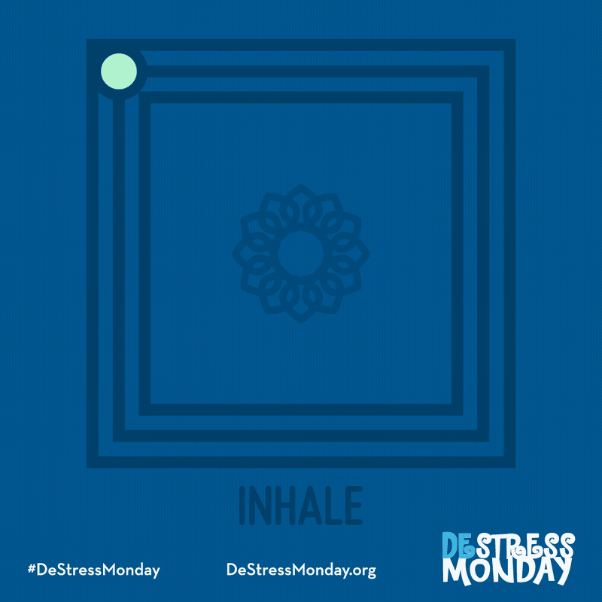
Breathing/Grounding Techniques
Notes:
When we feel anxious, upset or distressed, it can be difficult to know what to do to feel better. By using these breathing techniques, we can reduce our anxiety and lower our blood pressure/heart rate. This helps us feel calmer and more focused and helps us to face our fears.
Some more example techniques

Slide 18
Grounding Techniques

