Slide 1
Everyone Worries

Slide 2
Who are we?
Healthy Minds Team
Notes:
Short introduction to ourselves and Healthy Heads team
Explain confidentiality and exceptions

Slide 3
What is Anxiety?
a normal emotion that everyone experiences in their lives
a feeling of unease, eg. worry/fear.
It can sometimes get out of control
it can affect our daily lives making it difficult to do certain things.

Slide 4
Fight vs Flight
https://www.youtube.com/watch?v=SJhcn7Q0-LU
Notes:
Play fight vs flight youtube video to explain physical symptoms of anxiety and why they occur

Slide 5
There’s many different forms of anxiety
Social anxiety – worries and fears linked to social situations including – school, shops, playing out
Generalised anxiety – lots of different worries and fears. Constantly worrying about something.
Separation anxiety – worries about leaving their trusted person. Feelings of not being able to cope with out them.

Slide 6
Panic – experiencing extreme physical symptoms
Low mood – feelings of not a sense of enjoyment out of life
Other -
Specific Phobia
Health Anxiety
OCD

Slide 7
The Vicious Cycle…
Thoughts
What if I have to speak out and everyone stares at me ?
They will judge me and laugh at me
Physical symptoms
Sore tummy
Shaky
Emotions
Scared, nervous
Behaviours
Keep quiet
Ask not to go
Notes:
Go through this negative cycle as an example

Slide 8
Physical symptoms
Hot
Heart beating faster
Feeling sick
Headache
Struggling to concentrate
Disturbed sleep
Shaky
Notes:
On this slide you will see some examples of how a child may present/what physical symptoms they may experience as a result of anxiety

Slide 9
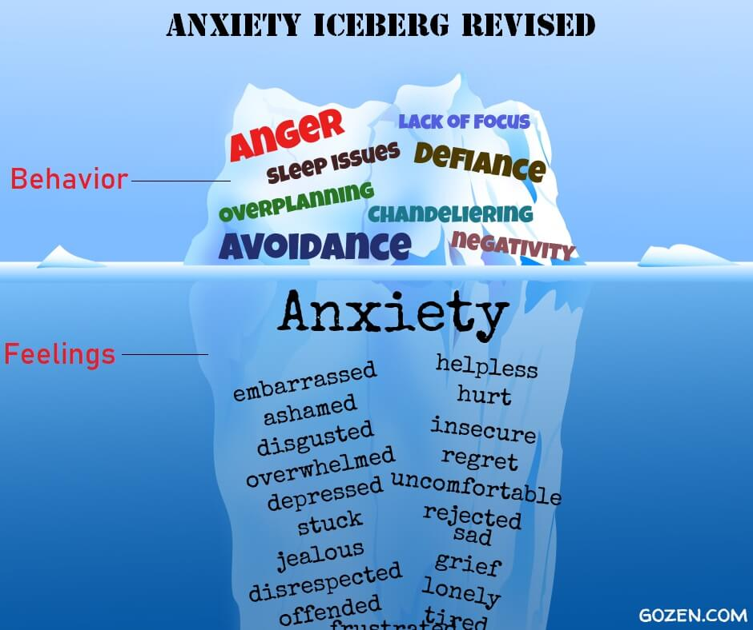
Feelings and Behaviour related to Anxiety and worries
Notes:
As well as avoidance and feelings of being unwell – anxiety can also be displayed in a child’s behaviour which may be interpreted as anger/defiance – this could be seen as child in ‘fight mode’.

Slide 10
Safety Behaviours
Avoidance - but we cannot avoid everything all of the time.
Distraction
Overthinking/overplanning
Needing someone/something with us
Routines – eg. Wearing certain items of clothing

Slide 11
The Role of Parents & Carers
Parents & Carers play a key role in supporting their child to manage difficult or strong emotions or stresses.
It is good for children and young people to be around supportive, trusted adults and parents during such a stressful situation.
This is often where children and young people turn to for reassurance and safety
Parental support is crucial for children and young people at such times.

Slide 12
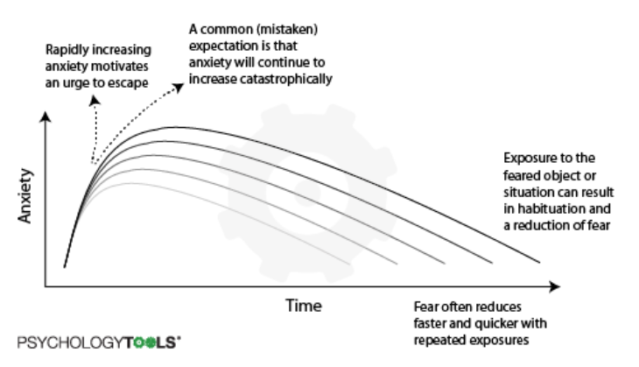
Habituation
Notes:
Prolonged and repetitive exposure required to overcome anxiety

Slide 13
Useful Strategies for parents
Notes:
As parents you are in the prime position to support your child. You are able to see them every day and small interactions can make the biggest difference to a young person.

Slide 14
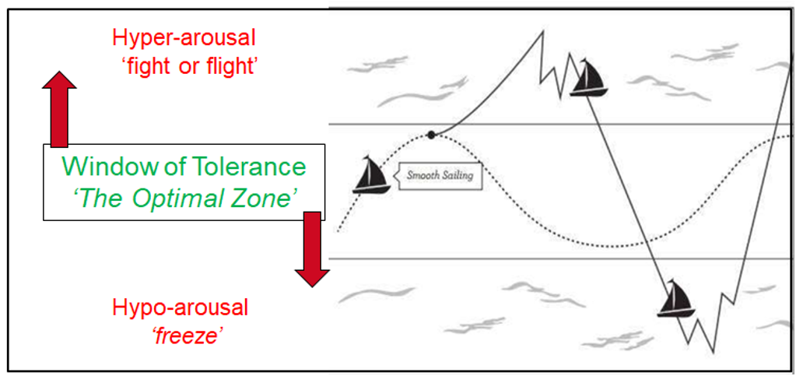
When you support a young person is as important as how you support them.
Notes:
Explaining that children and adults cannot access their rational brain when in the hyper arousal state – telling a child to make decisions or follow instructions at this time can often make the situation worse. If a child is in the hyperarousal state it is important to model strategies to help them regulate their emotions or give them time, and then offer a time for reflection or support after. But more ideally its about supporting children and giving them the strategies before they reach that ‘melt down’ point.

Slide 15
What factors can keep Anxiety going?
Reassurance
Negative thinking
Escaping from/Avoidance of situations
Notes:
All of these factors will be discussed in more detail in slides to follow

Slide 16
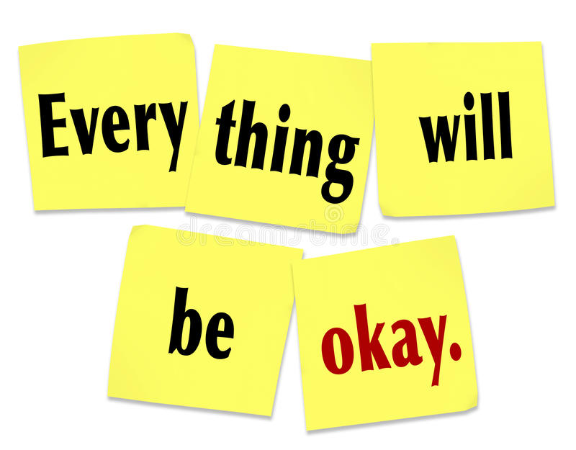
Reassurance
at some point we all reassure children and young people
It can be addictive – the more you give it the more they will seek it
it can help anxiety in the short term but not in the long term

Slide 17
Cutting out reassurance
Try to show empathy and validate the young person’s feelings instead
“I can see this is upsetting for you and you are worried, this must be very hard for you.”
“I can see this is scary for you, let us think about how we can make this less scary”
Notes:
Additional Comments can be made:
Emphasise to parents/carers we are not expecting them to cut this out immediately but gradually.
This is a natural response and therefore going to take time and practice.
It is important for you to share this with any other significant others who may give reassurance to your child so it is consistent.

Slide 18
Useful questions to ask instead
What is frightening you?
What do you think will happen?
What is the worst thing that might happen?
What is it about [this situation] which is making you worried?
Notes:
Another way of cutting out reassurance is through asking questions
*talk through each of the points above

Slide 19
Promoting Independence – Problem solving
Children often avoid trying new/anxiety provoking things
We all learn through experience
Children need the opportunity to develop independence, cope, succeed and try again if it doesn’t work out the first time
Young people often look to adults to ‘solve their problems’ and offer solutions
Giving opportunities for them to develop this skill is very important.
Notes:
Additional Comments can be made:
Sometimes when our children are anxious we step in to rescue them e.g. if we hear them stuttering, we speak for them
Reflect on age appropriate activities – page 109

Slide 20
Alternative Ways of Thinking
Let’s look at this a different way…
I don’t want to try something new I might not be good at at
It is something new I’m not supposed to know how to do it yet but I can give it a go and try my best.
Notes:
Reference to the thinking like a judge
Demonstrate example of this on a worksheet or on flipchart paper if available or just explain how you would follow the process of thought challenging.
Emphasise we are looking for FACTS not OPINIONS
(create own or use example below)
EXAMPLE:
Thought – I am going to fail my mock exams
Evidence for – I failed my last maths paper
Evidence against – I have never failed any mocks before, I got positive feedback from parents evening, my target grades are 5s, I have been revising on a night after school
Alternative Thought – I probably won’t fail my mocks if I do some revision

Slide 21
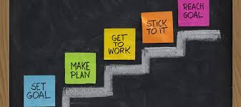
Setting goals
What would your child or young person like to be able to do, but can’t right now because of their anxiety?
Examples:
To put their hand up in class
To buy something from the shop
To go out with their friends more

Slide 22
Break goals down into small achievable steps
Notes:
Explain how breaking a goal down into small steps makes it look less overwhelming, the young person is more likely to get success meaning they will have higher levels of confidence and self esteem.

Slide 23
Other things to do to help..
Teach children that anxiety is a normal response
offer praise for brave behaviours
Gradually reduce reassurance giving
Challenge anxious thoughts with factual evidence
Keep an eye out for safety behaviours
Support young people with any step plans

Slide 24
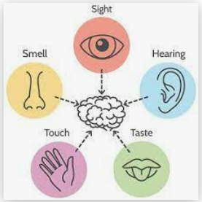
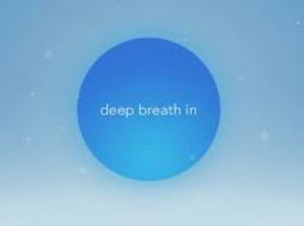
Relaxation and calming strategies
Breathing
5 senses
Relaxing/enjoyable activities
Activities I enjoy
________
________
________
________
________
________
Notes:
Explaining the benefit of relaxation and grounding techniques (relating back to the window of tolerance) and doing activities we enjoy.

Slide 25
Further reading

Slide 26
General Tips to help manage anxiety
Regular exercise
a good balanced diet remembering the 5 a day rule
Avoid too much caffeine (coke, coffee, tea, chocolate)
Doing things we find relaxing/enjoyable

Slide 27
Next steps
If you still have concerns about your child or young persons difficulties further support can be accessed from the Healthy Minds MHST
Requests for support can be completed through your child or young person’s Education setting
Discuss with setting Mental Health Lead or Pastoral team who will liaise with us.

Slide 28
Feedback from today and any questions?

